Slide 1
Web Application for
Hotel Room Reservation
End of Studies Internship

Slide 2
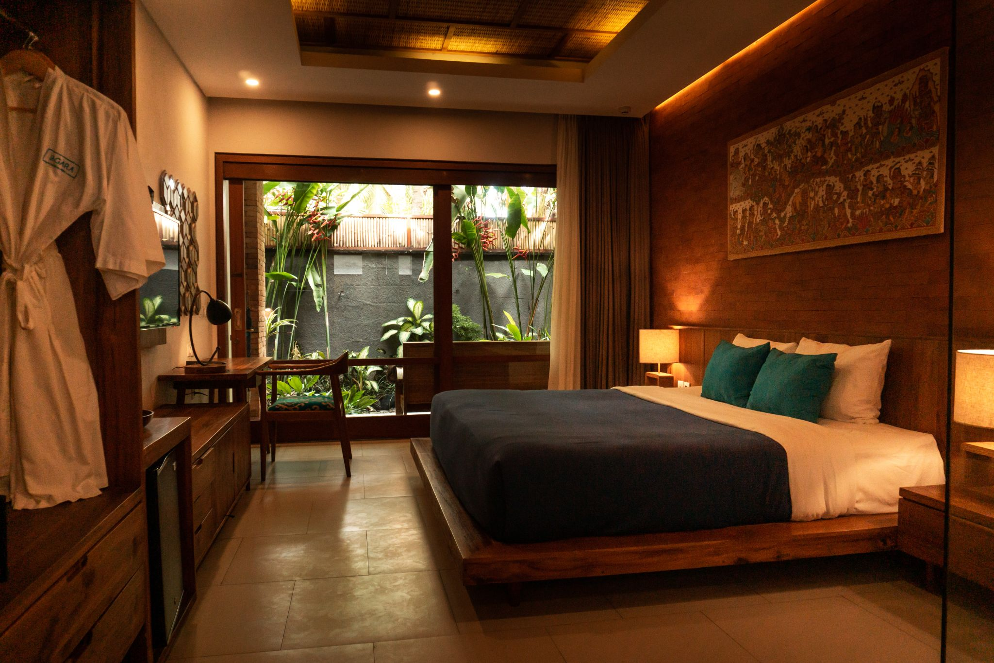
Web Application for Hotel Room Reservation
This website was created, in a period of 2 months, as a graduation internship at ZINNOVATION & the Agadir Higher School of Technology – Ibn Zohr University
Created by
Mr. Hamza AIT BOURHIM
School supervisor
Dr. Mustapha AMROUCH
Internship supervisor
Mr. Anass ELHOUISSIQUE

Slide 3
PLAN

Slide 4
Introduction
Design & Development Tools
Conclusion
1
2
3
4
5
Presentation of the host organization
Simulation

Slide 5
INTRODUCTION

Slide 6
The problem
Main Problem
New Technology
Other Requirements
Creating a web application template for hotels websites creation
Learning to work with PHP and MySQL, and secure their connection
Learning how to manage a project with strict deadlines

Slide 7
PRESENTATION OF THE HOST ORGANIZATION

Slide 8

ZINNOVATION
Z INNOVATION is a digital development workshop in Agadir dedicated to robotic and electronic projects, with the aim of facilitating product innovation and developing creativity.
Block B1 N ° 21 Cité EL Qods Agadir 80000 Morocco

Slide 9


Z INNOVATION services

Slide 10



Z INNOVATION partners

Slide 11
DESIGN & DEVELOPMENT TOOLS

Slide 12
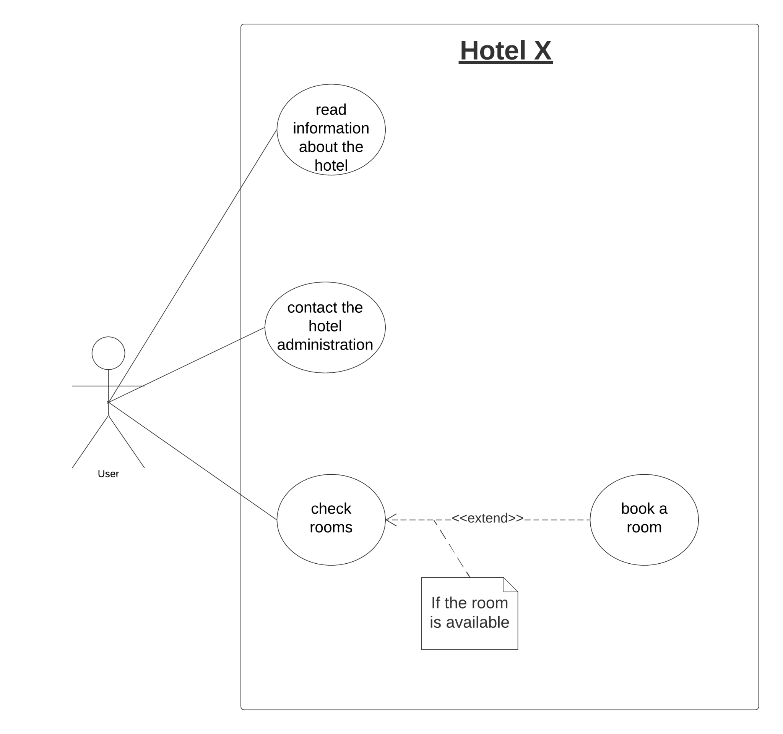
DEVELOPMENT TOOLS
Use case diagram

Slide 13
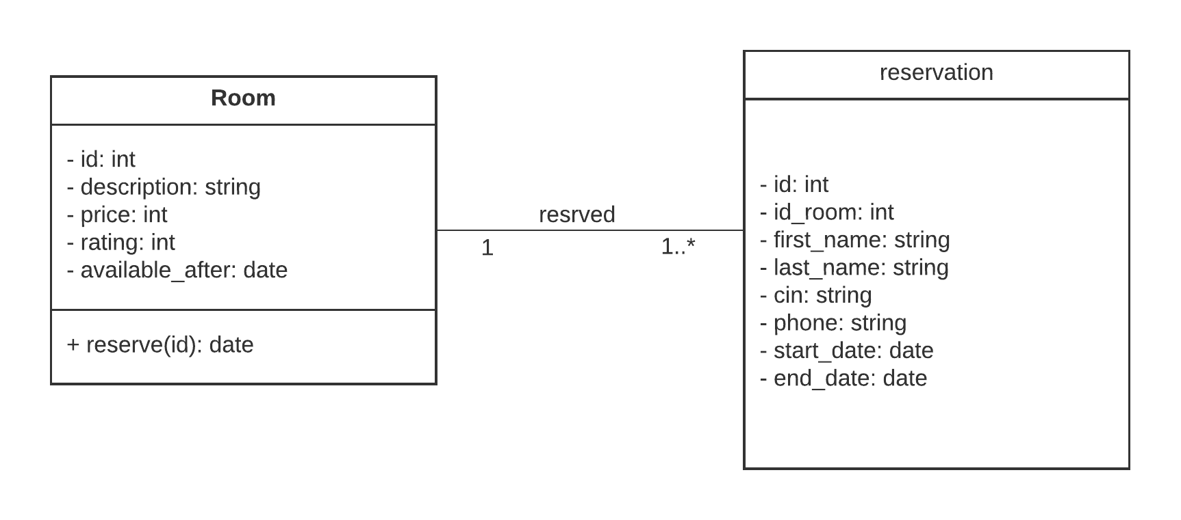
Class diagram
DEVELOPMENT TOOLS

Slide 14





DEVELOPMENT TOOLS

Slide 15
SIMULATION

Slide 16
CONCLUSION

Slide 17
This end-of-study internship was very positive and allowed me to enrich my knowledge and my know-how and has brought me a lot professionally by integrating into the tasks within the workshop, and the completion of this project allowed me to acquire new knowledge using a new programming language.
My approach in this work was to focus on services and to implement graphical interfaces offering simplicity and clarity.
In the end, I hope that this project will be able to satisfy my teachers and my internship supervisor Mr. Anass ELHOUISSIQUE and I would like to thank them all.

Slide 18
Thank You
For Your Attention.
Source: https://github.com/hamzaaitbourhim/hotel_room_reservation

